Slide 1

ONLINE PIZZA ORDERING SYSTEM

Slide 2
Objectives
Customer :
Customer should have an account in the Pizza Hunt to place an order.
Otherwise they need to create an account in the Pizza Hunt to place an order.
They can select their favorite pizza by placing an order.
Finally they can confirm their order by entering their delivery address.

Slide 3
Objectives
Owner :
Owner should also have an account in the Pizza Hunt to make modifications in the Pizza.
Otherwise they need to create an account in the Pizza Hunt.
They can Update the Pizza, Delete the Pizza, Add new Pizza and they can View the Orders placed by their customers.
After completing the order to their customers , they can delete that particular order.

Slide 4
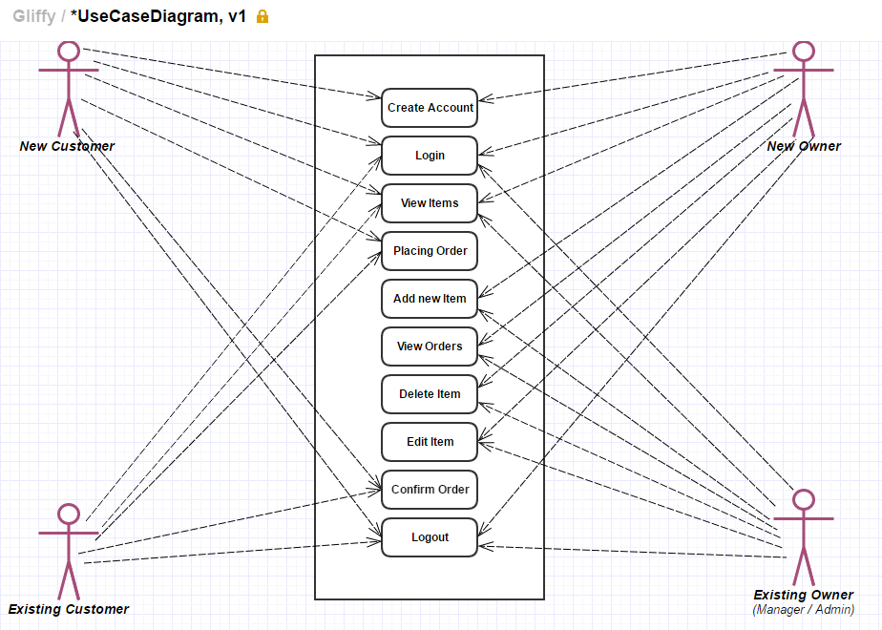
Use Case Diagram

Slide 5
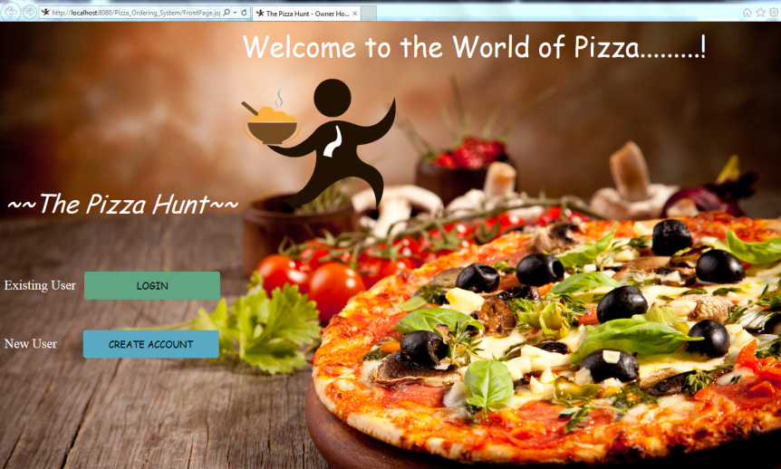
Demo Lets start with the Owner

Slide 6
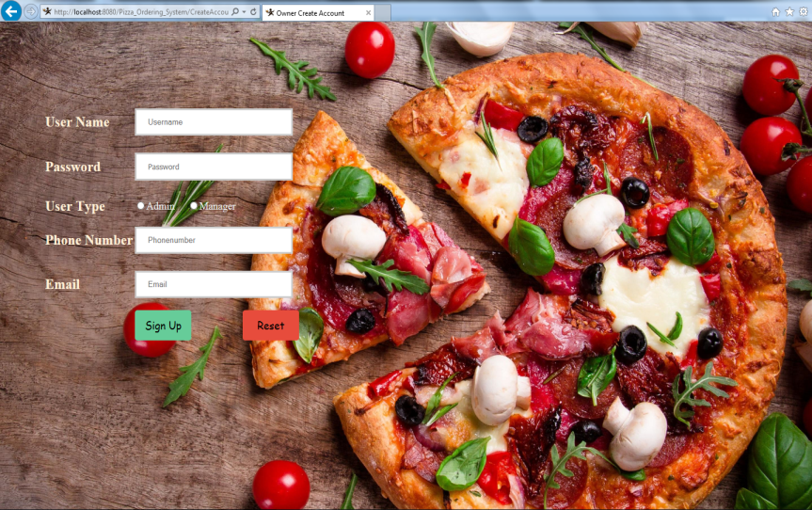
Creating an Account

Slide 7
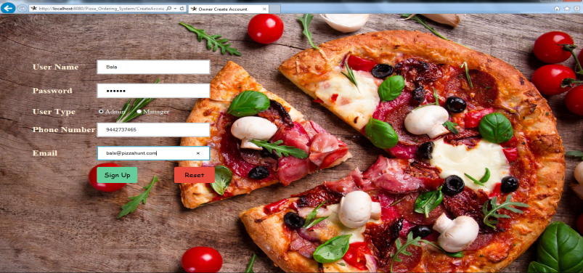
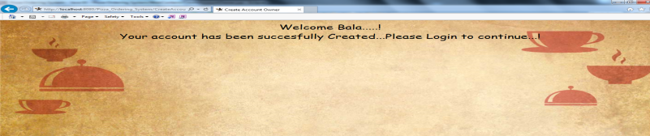
Creating an Account

Slide 8
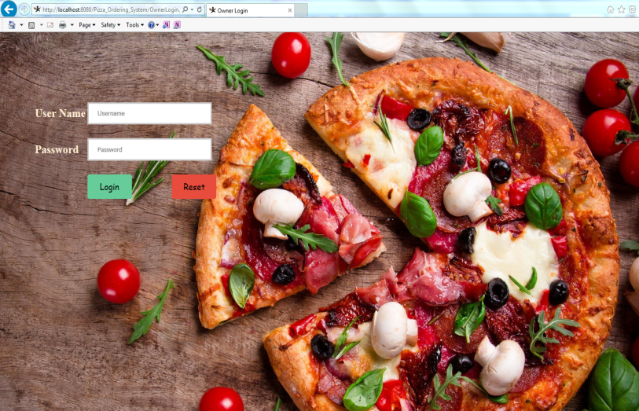
The Admin has been now redirected to login page..

Slide 9
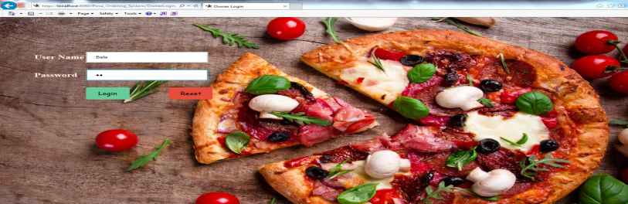
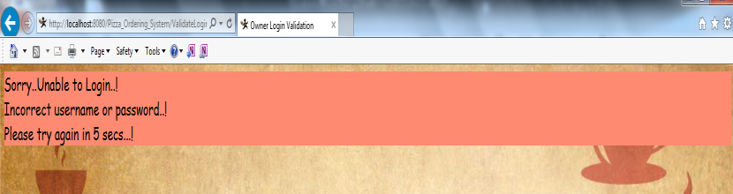
If the Admin tries to login with unknown credentials, it will automatically redirected to the front page….

Slide 10
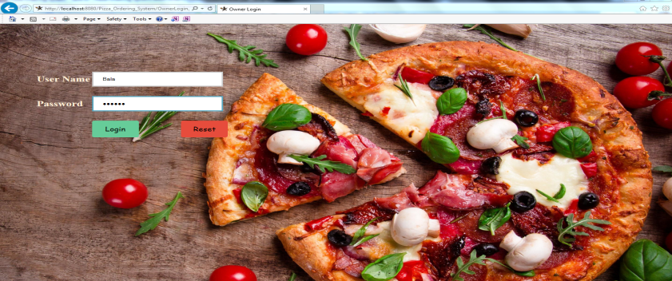
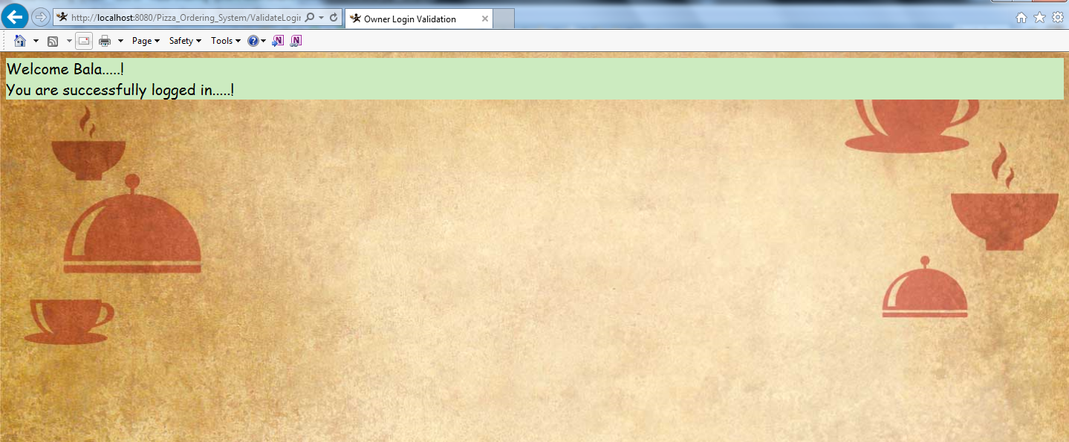
Logging in with correct credentials..

Slide 11
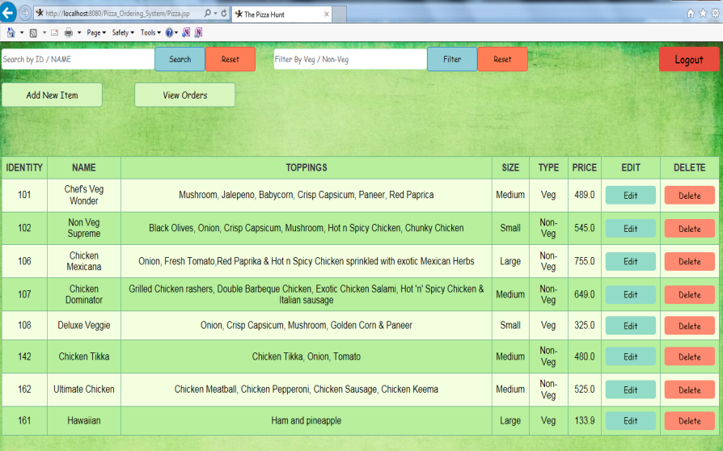
This is Menu page for the Pizza Owner…

Slide 12
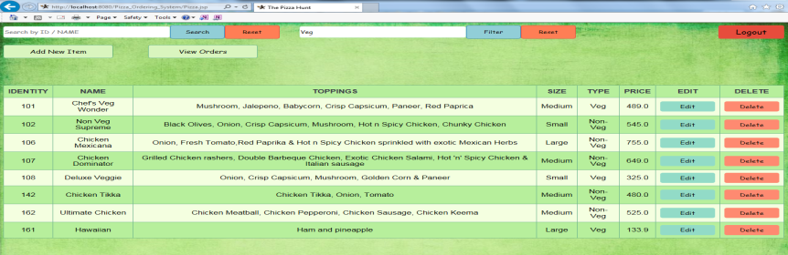
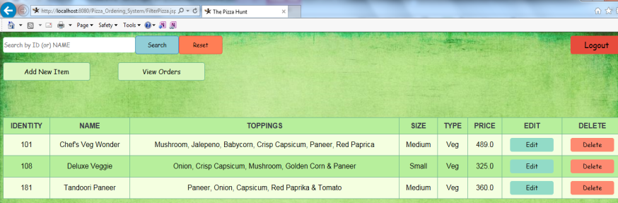
Admin can filter the pizza by Veg/Non-Veg..

Slide 13
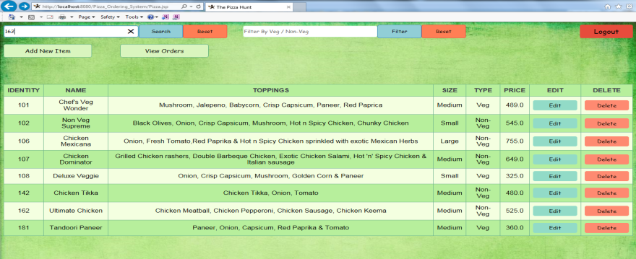
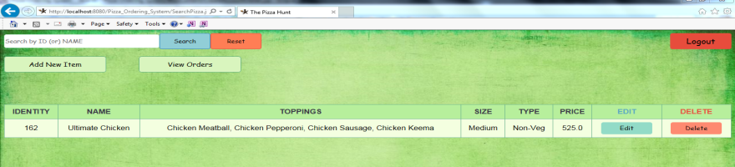
Admin can search Pizza either by Id or by Name..

Slide 14
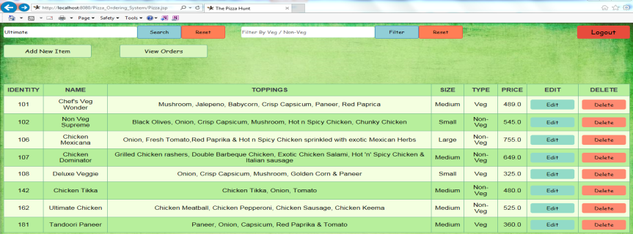
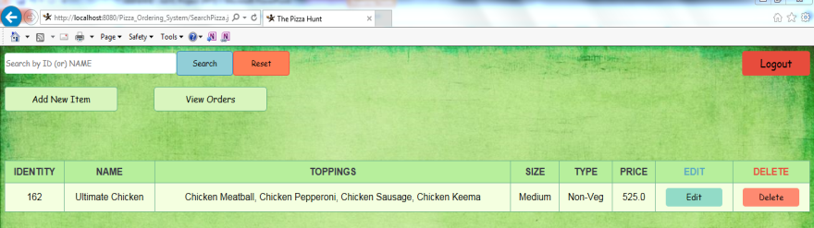
Admin can search Pizza either by Id or by Name..

Slide 15
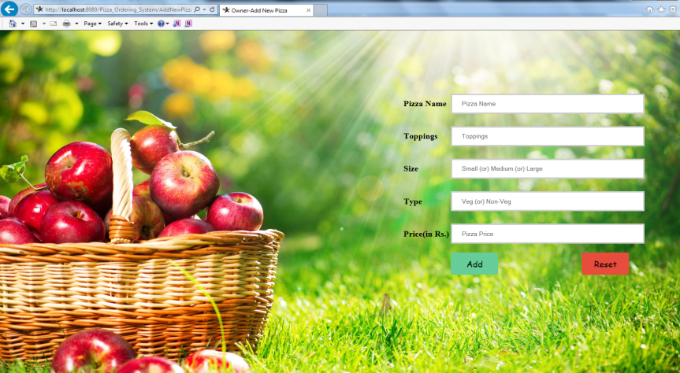
Admin can add New Pizza in the Menu by clicking Add New Item..

Slide 16
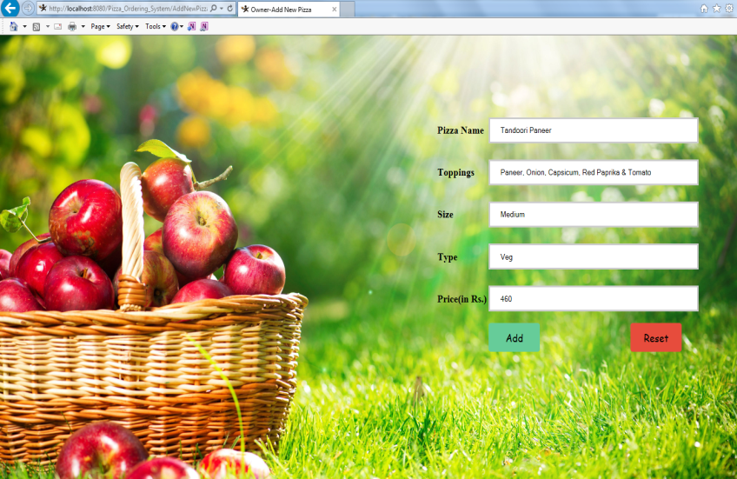
Admin is adding Pizza named “Tandoori Paneer”..

Slide 17
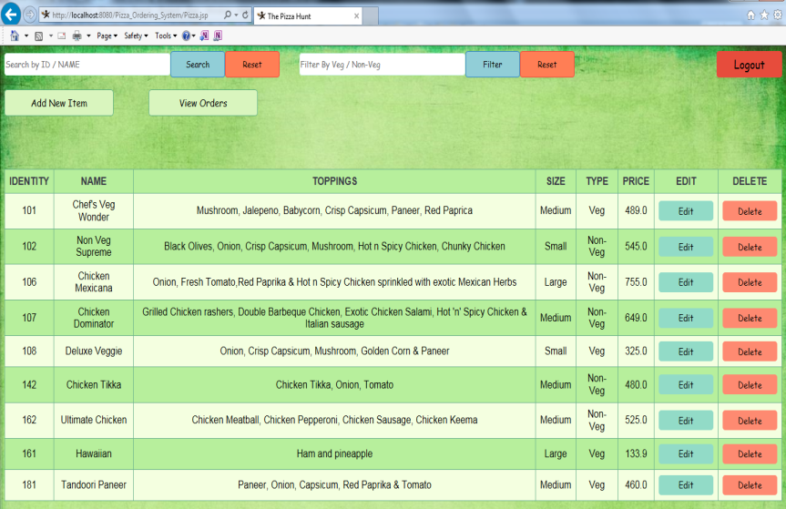
“Tandoori Paneer” has been successfully added to the menu..

Slide 18
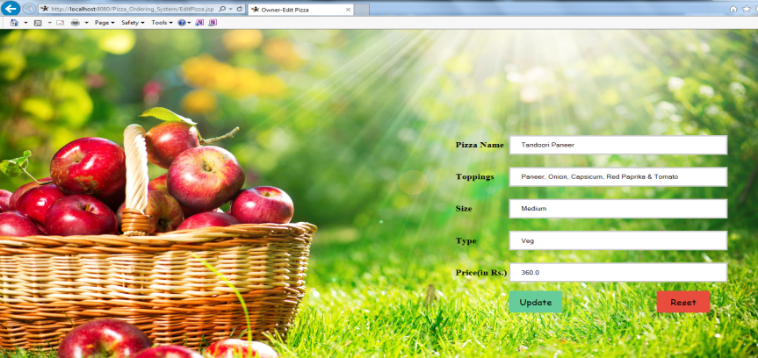
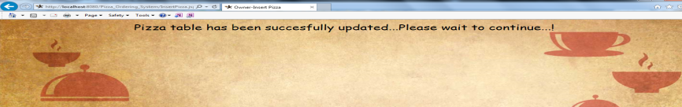
Now Admin is updating “Tandoori Paneer” by altering the price from 460 to 360 by clicking Edit option...

Slide 19
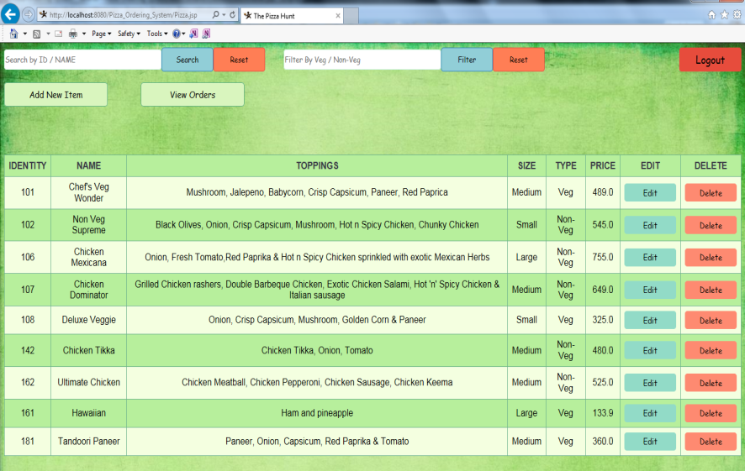
“Tandoori Paneer” has been successfully updated..

Slide 20
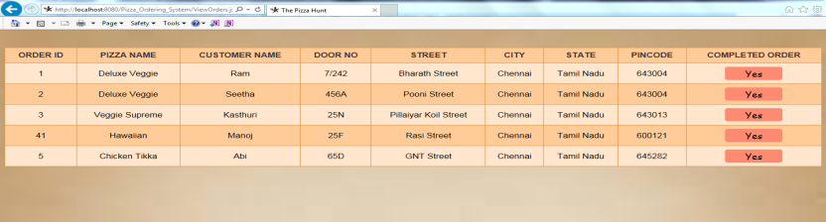
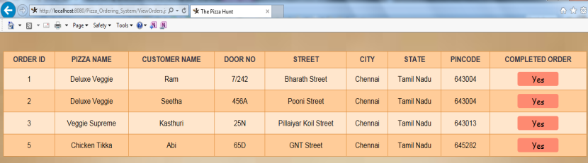
By clicking View Orders the Admin can able to see the orders..
Once they completed the order they can delete that particular order by clicking “Yes”…
Here the order with Order Id “41” has been successfully completed..

Slide 21
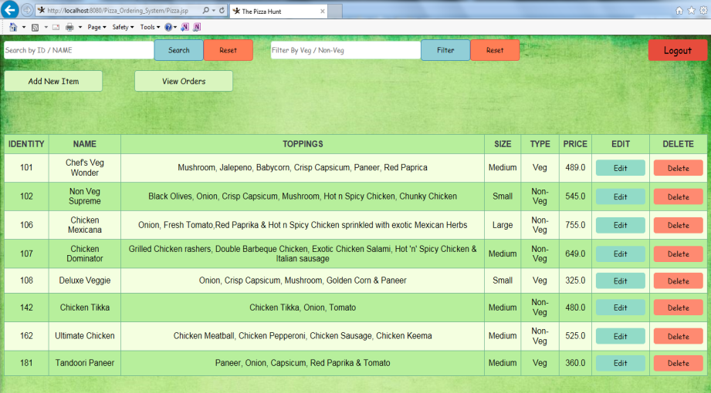
Admin can also delete particular Pizza in the menu by clicking delete option..
Admin deleted the Pizza named “Hawaiian”..

Slide 22

Customer Part..
Home Page :

Slide 23
Customer should also have an account in the “The Pizza Hunt” to login.
Otherwise he/she have to create an account in the “The Pizza Hunt”..
Customer “Ram” is an existing customer.
When he tries to login with unknown credentials, he will automatically get redirected to the home page.

Slide 24
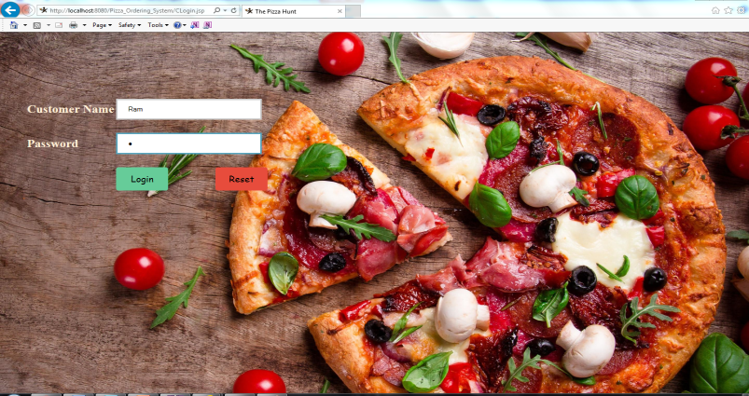
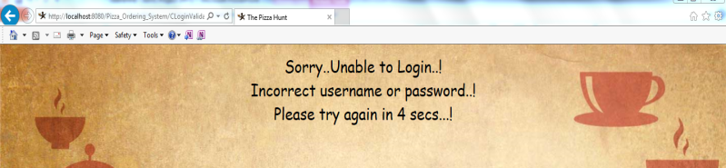
Customer Ram with unknown credentials..

Slide 25
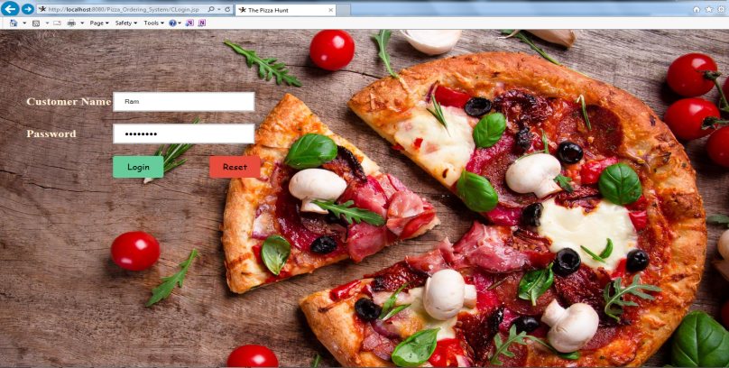
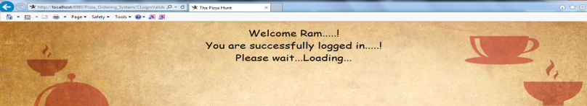
Customer Ram with correct credentials..

Slide 26
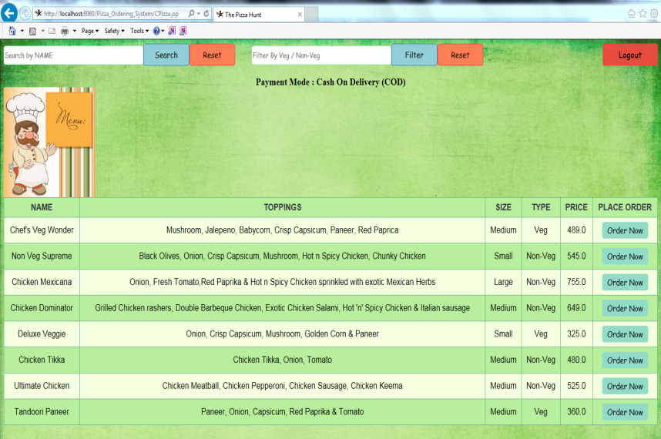
Customer - Pizza Menu Page

Slide 27
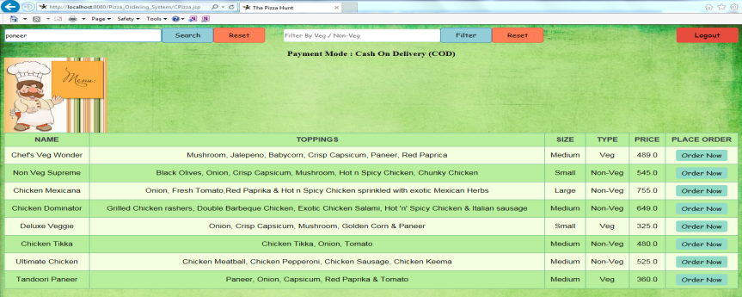
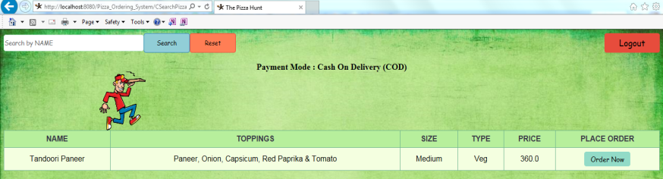
Customer can search their Pizza by Name..

Slide 28
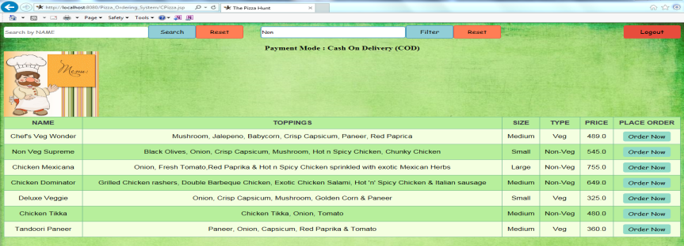
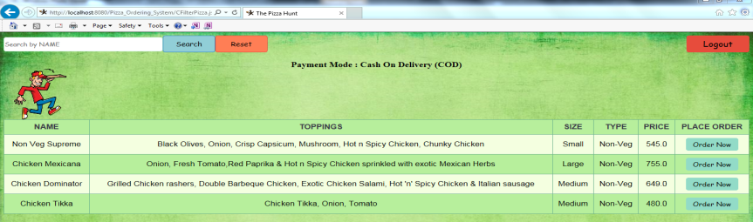
Customer can filter their Pizza by Veg/Non-Veg..

Slide 29
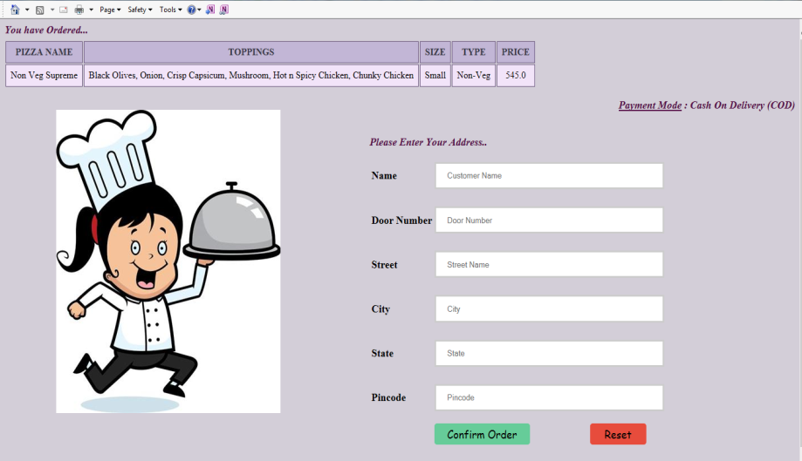
Customer can place their order by clicking “Order Now”option..
Customer has selected his Pizza named “Non Veg Supreme”..

Slide 30
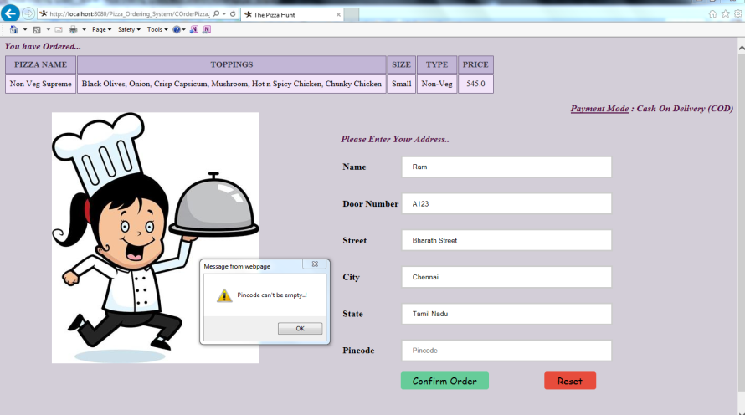
Customer can confirm their order by clicking “Confirm Order”..
Customer should enter their delivery address details to confirm their order.
And all the details must be filled, or an alert message will be generated.

Slide 31
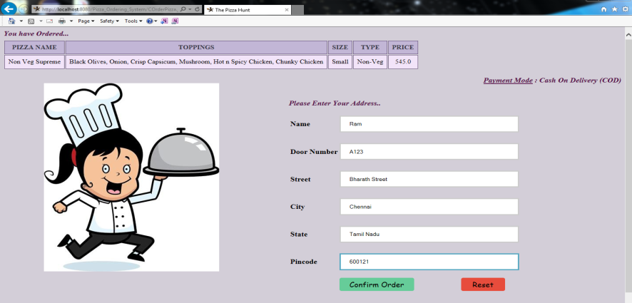
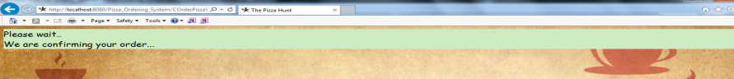
After entering the delivery address details, customer can confirm their order by clicking “Confirm Order option”..

Slide 32
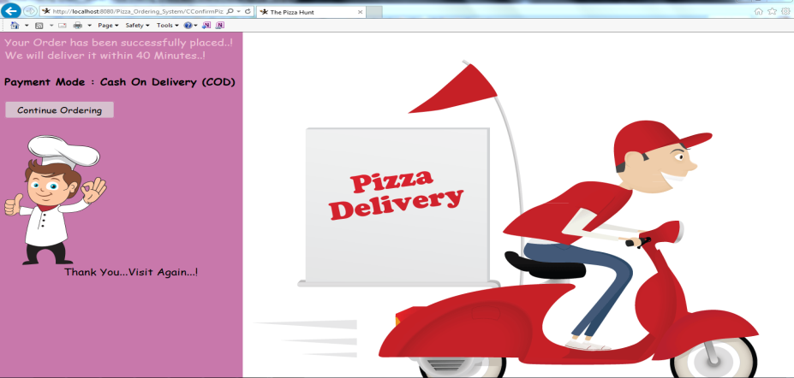
Confirmation Message
Customers can continue their order by clicking “Continue ordering”.
Then, it will get redirected to the Pizza Menu Page.

Slide 33
The customer can log out by clicking “Logout” option. It will take the customer to their Home page.
The Pizza Owner can view the orders placed by their customers by clicking “View Orders” as shown earlier.
Once the order has been placed, Admin can delete that particular order.

Slide 34


